Slide 2
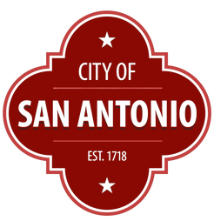
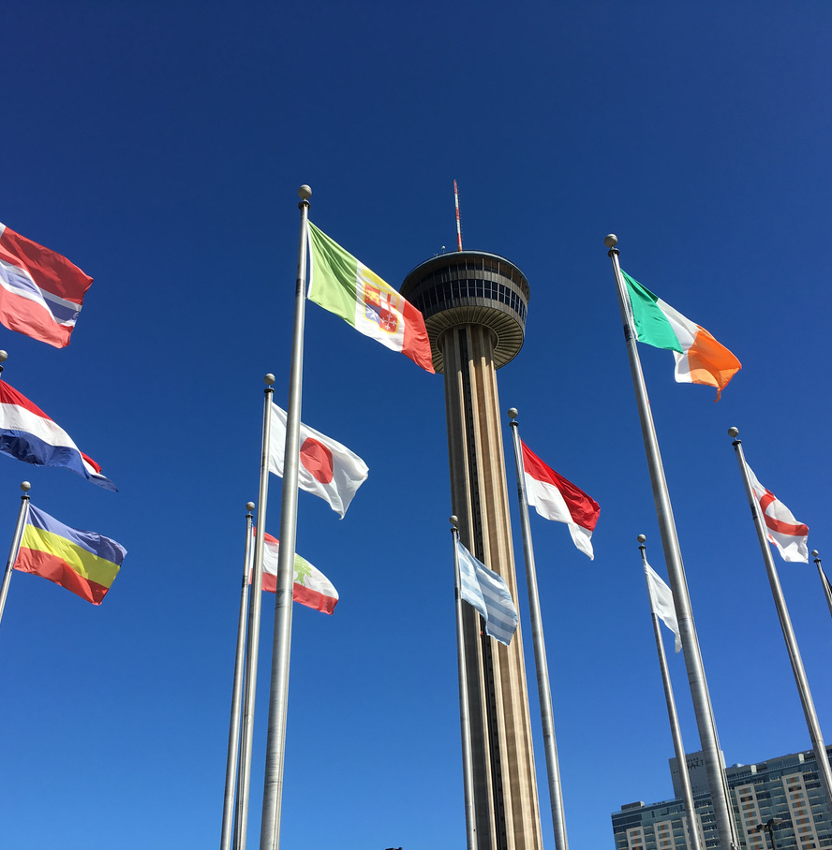
EDUCATION HIGHLIGHTS
Foreign students play a vital role locally as they bring varied perspectives to our campuses and our city. They contribute to the advancement of research, knowledge and technology and become important ambassadors and connectors upon their return to their home countries.
01
02
San Antonio is the only Texas city with universities from both the University of Texas and the Texas A&M systems.
Home to the largest defense medical center and one of the largest concentrations of military bases in the U.S. at Joint Base San Antonio-Fort Sam Houston.
03
Diverse population and cultural influences include Indigenous, Mexican, Tejano, German, Irish, Czech, Slovak, Indian, and more.
04
Major industries include Bioscience, Technology, Cyber Security, Aerospace, Financial Services, and Manufacturing.

Slide 3
HIGHER EDUCATION INSTITUTIONAL PILLARS
Public Institutions | Private Institutions | Specialized Higher Education | Medical/ Research Institutes | Intensive English Language Studies | Technical & Vocational Institutes
Universities: Texas A&M University - San Antonio Texas State University (San Marcos) University of Texas at San Antonio UT Health San Antonio Community Colleges: The Alamo Colleges District includes five campuses: *Northeast Lakeview College *Northwest Vista College *Palo Alto College *San Antonio College *St. Philip’s College | Oblate School of Theology Our Lady of the Lake University St. Mary’s University Texas Lutheran University (Seguin) Trinity University University of the Incarnate Word Wayland Baptist University - San Antonio | Culinary Institute of America (CIA in San Antonio) St. Mary’s University School of Law Universidad Nacional Autónoma de México - San Antonio | UT Health San Antonio UTHealth Houston School of Public Health in San Antonio University of the Incarnate Word START Center for Cancer Care Southwest Research Institute Texas Biomedical Research Institute | Alamo Colleges District - San Antonio College Our Lady of the Lake University St. Mary’s University Universidad Nacional Autónoma de México - San Antonio University of Texas at San Antonio | Hallmark University Codeup San Antonio Tech Talent South Geekdom A collaborative co-working space and a hub providing mentorship opportunities

Slide 4
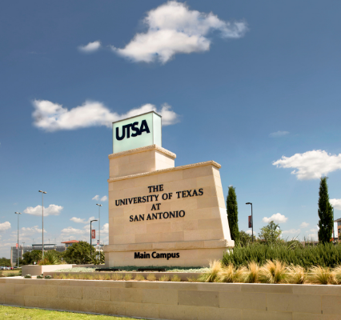
The University of Texas at San Antonio is a Research One (R1) University, which places UTSA among the top 100 universities in the United States.
A leader in data science, cybersecurity, engineering, biological sciences, and business, UTSA has 34,000+ students and a growing catalog of 200+ unique programs.
Through experiential learning UTSA is creating bold futures for students seeking jobs in competitive industries for today and tomorrow.
Texas has one of the strongest state economies in the nation and the world, ranking as the 9th largest GDP worldwide.

Slide 5
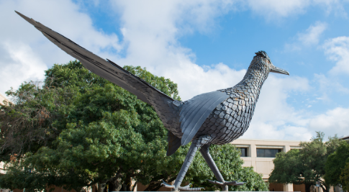
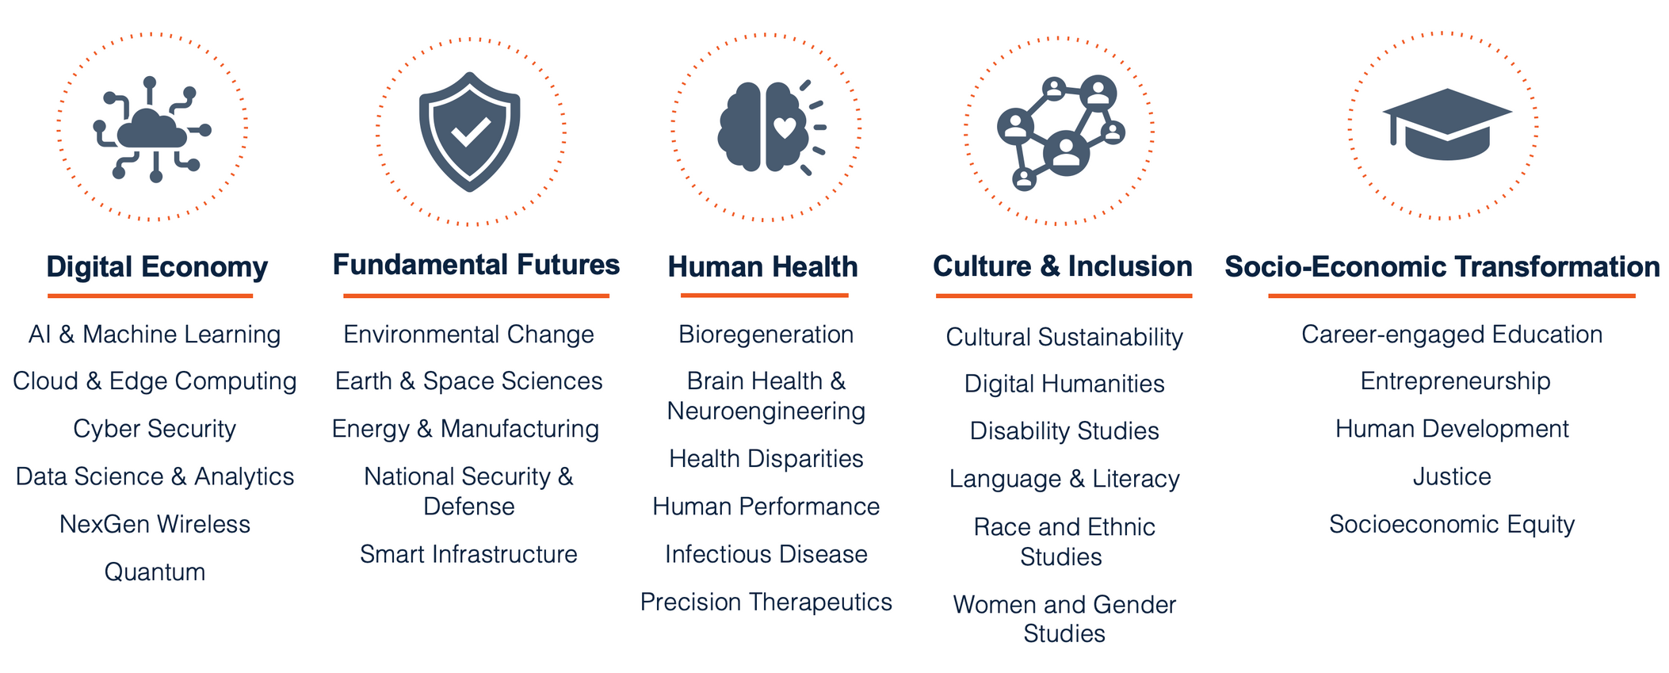
RESEARCH PILLARS
UTSA’s research community is strengthened by faculty with recognized expertise in many diverse fields including engineering, bioscience, environmental science, education, sociology, information technology, business, and others, and by first-class laboratories and research facilities.
With research partnerships that include other universities, corporations, government, and the military, UTSA plays a major role in the advancement of biomedicine, manufacturing, cybersecurity, education, and other areas that impact lives.

